Slide 1
Compression strategy using autoencoders & SfM reconstruction Project B.2
3D augmented reality
a.a. 2020/21
De Toni Alberto - 1236657
Nicola Casagrande - 1242363
University of Padova

Slide 2
CONTENTS
Here’s what you’ll find in this Slidesgo template:
A slide structure based on a multi-purpose presentation for education, which you can easily adapt to your needs. For more info on how to edit the template, please visit Slidesgo School or read our FAQs.
An assortment of pictures and illustrations that are suitable for use in the presentation can be found in the two alternative resources slides.
A thanks slide, which you must keep so that proper credits for our design are given.
A resources slide, where you’ll find links to all the elements used in the template.
Instructions for use.
Final slides with:
The fonts and colors used in the template.
A selection of illustrations. You can also customize and animate them as you wish with the online editor. Visit Storyset by Freepik to find more.
More infographic resources, whose size and color can be edited.
Sets of customizable icons of the following themes: general, business, avatar, creative process, education, help & support, medical, nature, performing arts, SEO & marketing, and teamwork.
You can delete this slide when you’re done editing the presentation.

Slide 3
OBJECTIVE:
Design a compression strategy for local SURF descriptors using autoencoders. Training data can be generated using the images of dataset Portello and Castle. Testing must be done on dataset FountainP-11 and Tiso. The reconstructed descriptors (only for the test set) are used to perform a SfM reconstruction using COLMAP (using the two test dataset).
Programming languages: MATLAB/Python/C++.

Slide 4
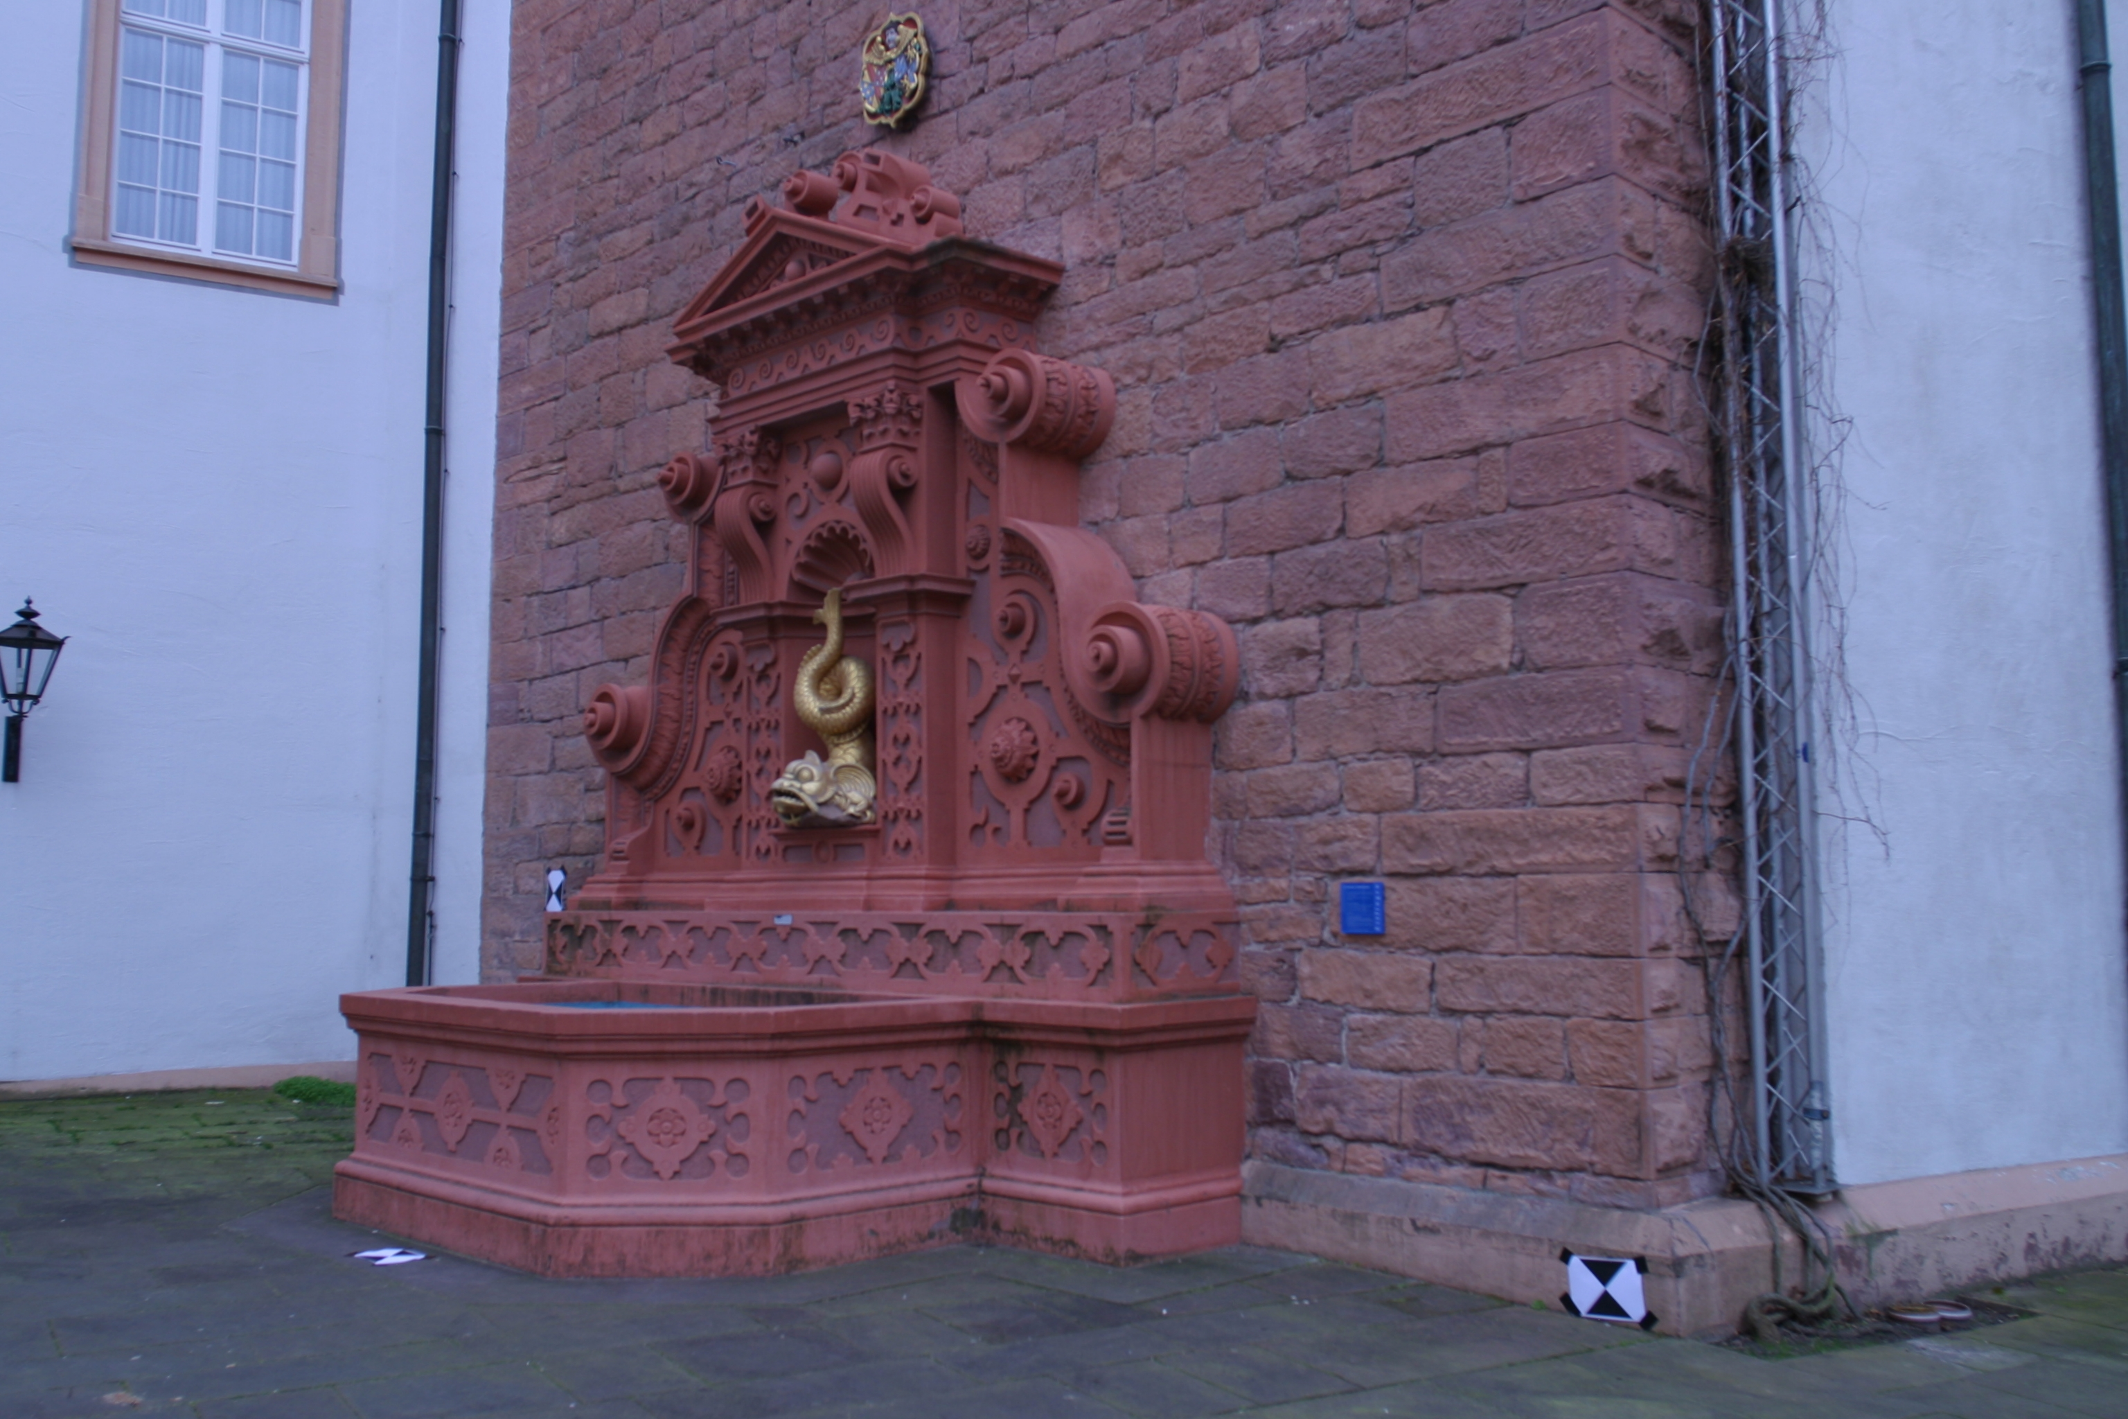
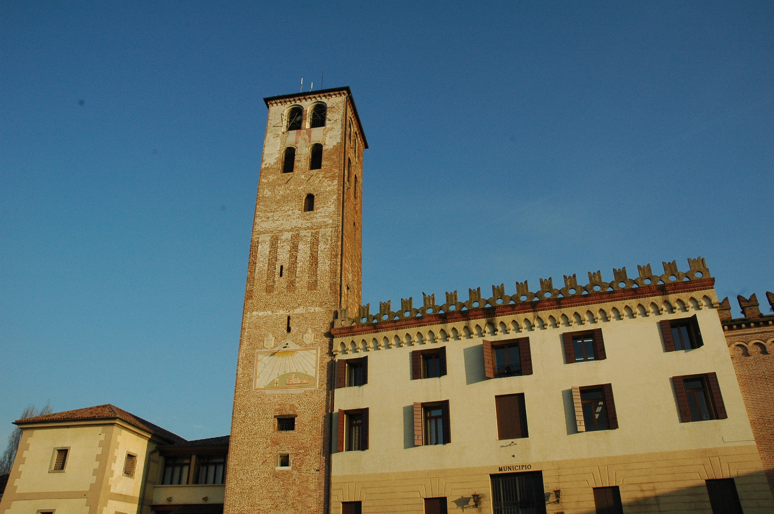
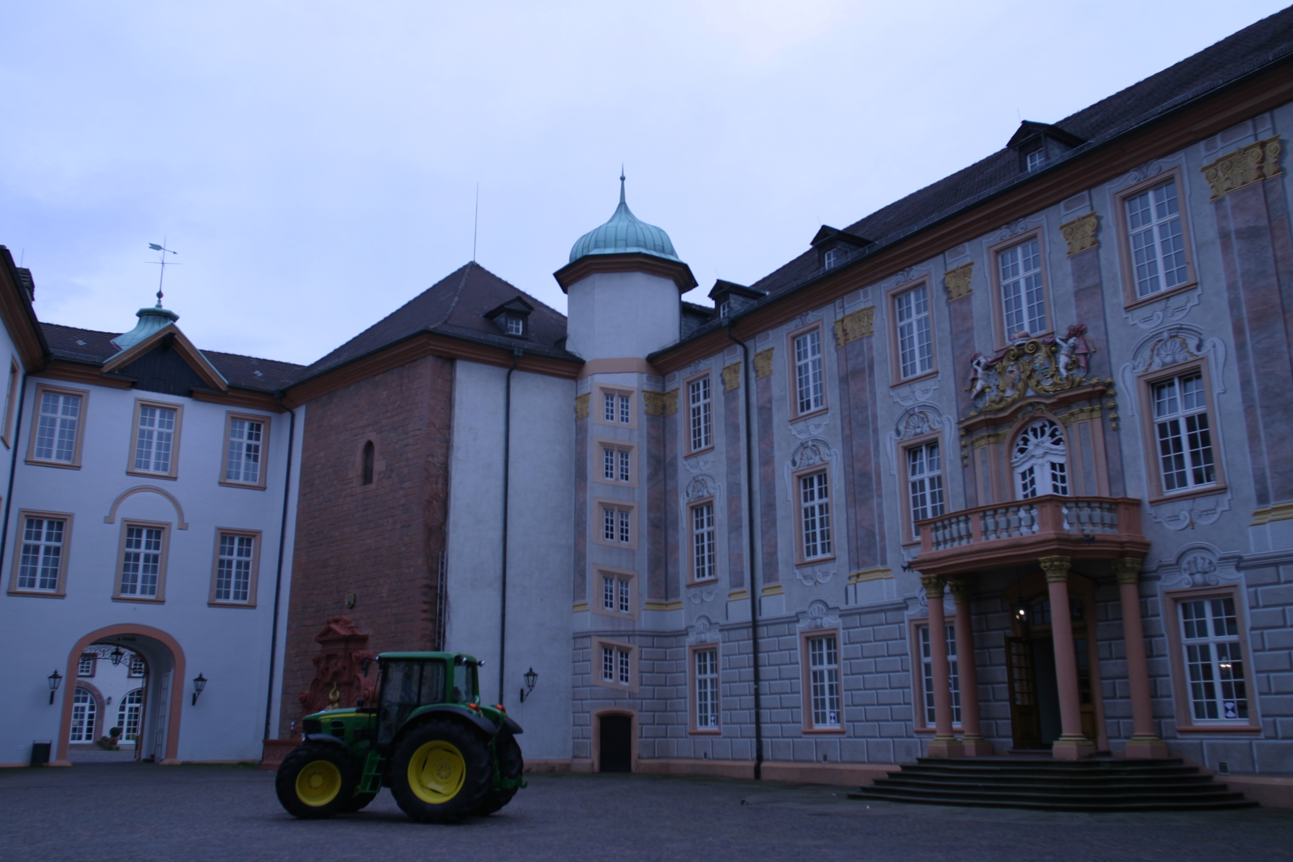
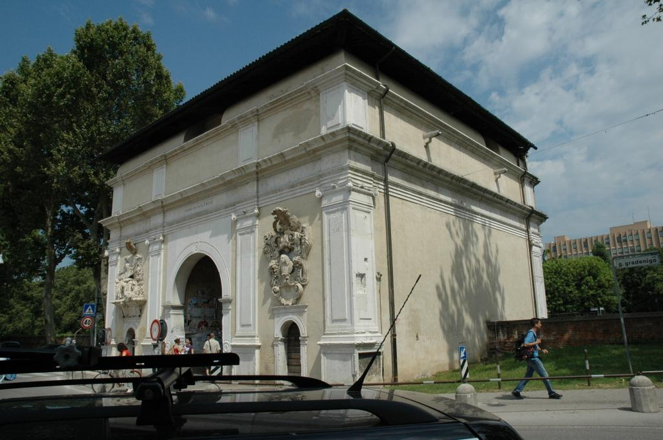
Data
Datasets were pictures of four architectural elements taken from different perspectives.
Testing
Training

Slide 5
TRAINING
The code gets divided in two sections: Training and Testing.
The images from the training set are loaded into a single image datastore.
A loop for each image is designed in order to:
1. Convert the image to grayscale;
2. Detect the SURF features (using the MATLAB function “detectSURFFeatures”);
3. Extract the features (descriptors) using the function “extractFeatures”. In this case they are represented as a vector of 64 columns and N rows;
4. Stack vertically the descriptors of each image in a single matrix.

Slide 6
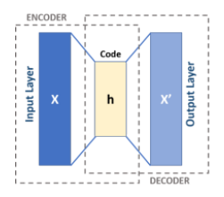
AUTOENCODER
The autoencoder has been built using the MATLAB function “layerGraph”.
We chose the following three-layer structure:
an input layer that receives features of dimension 64 (using “featureInputLayer(64)”);
 two fully connected layers of dimension 6 and 64 (using “fullyConnectedLayer(6)” and “fullyConnectedLayer(64)”), the second one having dimension 64 as will work as output layer;
a regression layer that will predict the reconstructed values (using “regressionLayer”).
ADAM (Adaptive Moment Estimation) optimizer
2 Epochs

Slide 7
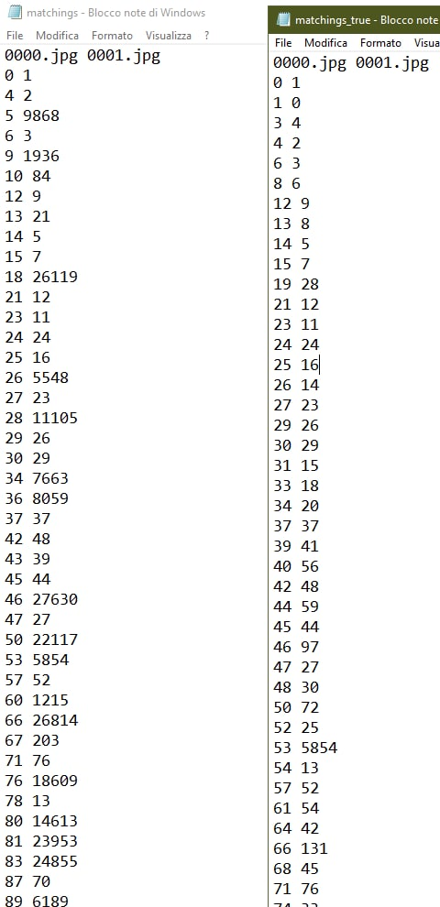
TESTING
MATCHINGS(imdsTiso, FEATURES(imdsTiso, autoenc));
The function FEATURES extracts the features from the test dataset and saves the keypoints in a .txt file while the descriptors are fed into the function MATCHINGS, which calculates the matchings between each couple of images and saves them in another .txt file.
With autoencoder
Without autoencoder

Slide 8
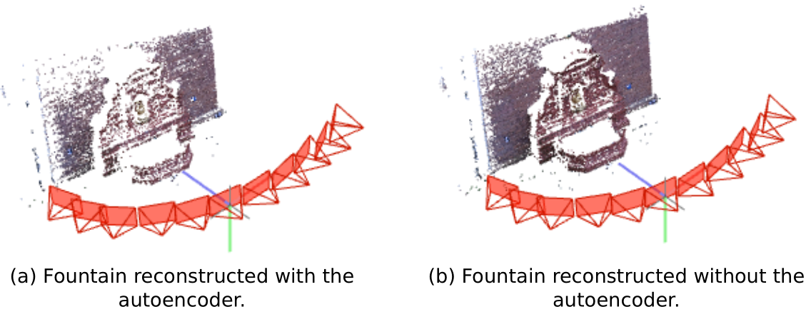
COLMAP RESULTS

Slide 9
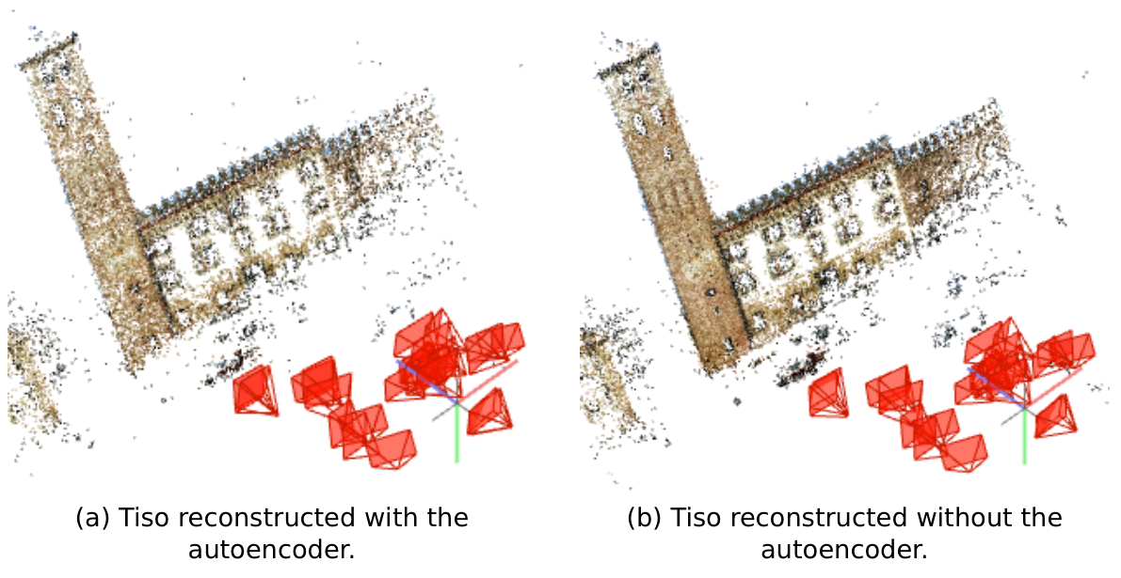
COLMAP RESULTS

Slide 10
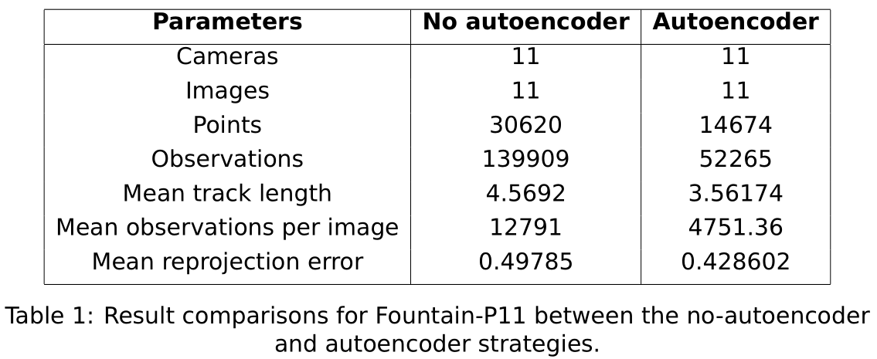
SOME STATS

Slide 11
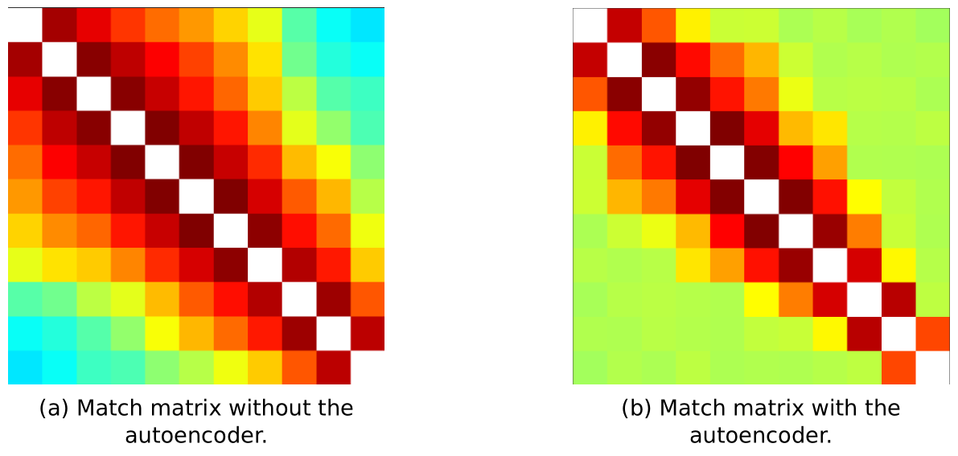
SOME STATS

Slide 12
CONCLUSIONS
This strategy is a lossy compression.
It can be useful in environments where the quality of reconstruction is not important, for example in object detection.
The edges of the objects are mostly preserved while straight planes are “thinned out”, i.e. represented with less points.
Other few matches can be found in randomic places.

